Slide 1

Information for Foundation parents

Slide 2
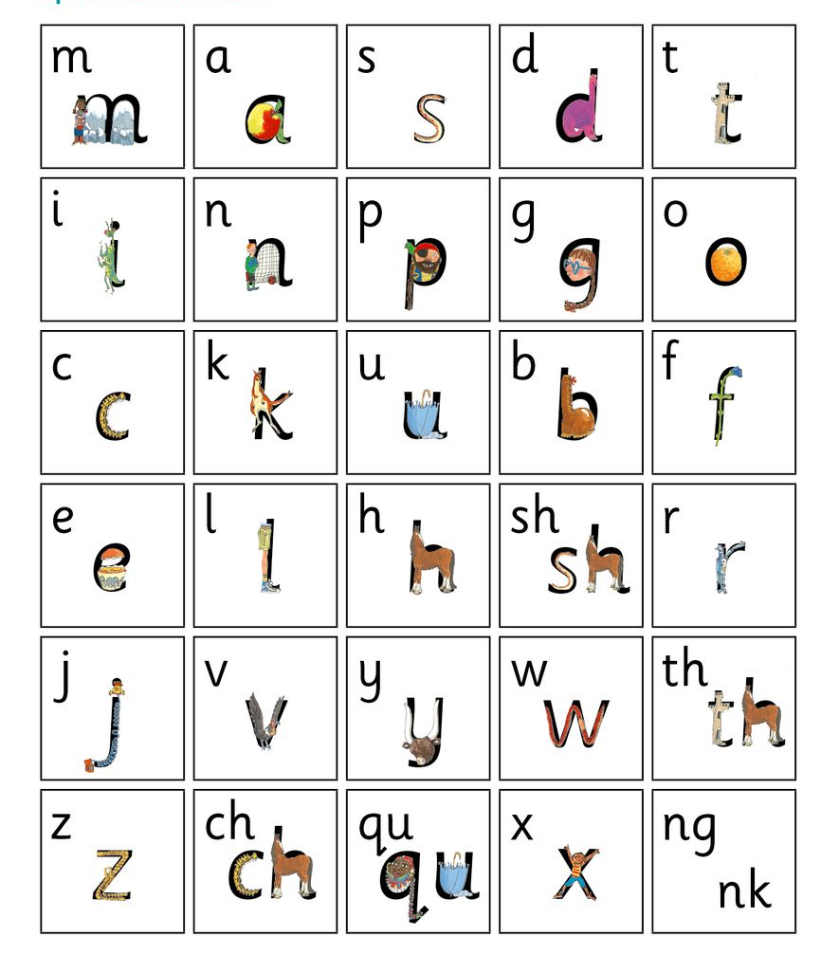
Children will start with learning Set 1 sounds
Alongside these they also learn red words (sight or tricky words), which are difficult to blend but are words they need to read and access texts (e.g. the, said, your).
Red words will eventually come home in the form of bookmarks with the red words they will encounter in the level they are working at.
What can you do to help?
Practise sounds at home - when homework comes home assist and supervise students to practice correct letter formation as they say the sound when writing.
Use letter sounds – not names of letters.
Practise reading red words at home.

Slide 3
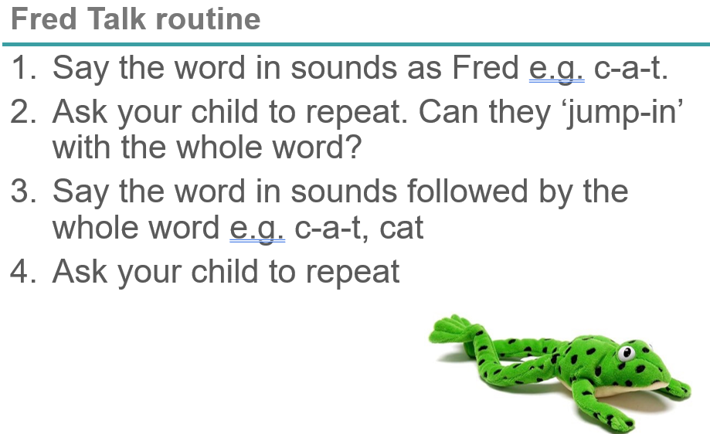
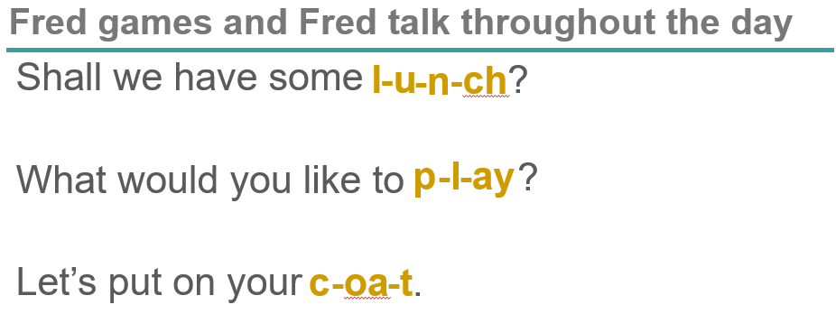
Developing phonemic awareness
Listening for sounds – it is important for children to develop the ability to hear sounds before they can read. They will be learning this at school through a process we call ‘Fred Talk’ (Fred is a frog who only talks in sounds).
You can also support this at home using the following ideas:
Say the word in sounds as Fred eg. c-a-t.
Ask your child to repeat. Can they ‘jump-in’ with the whole word?
Say the word in sounds followed by the whole word eg. c-a-t, cat
Ask your child to repeat

Slide 4
When will my child bring home readers?
We use a synthetic phonics approach to teaching reading. This method ensures students first develop a correct understanding of the reading process, before they begin to read simple phonic based texts. Therefore your child will only bring home readers after we have ensured they can:
• quickly and accurately recognise the sounds of the alphabet (not the name of the letters) that have been taught
• blend simple sounds to hear the words ‘they make’ e.g. “p-i-g makes pig.” “b-u-s makes bus.”
This focus on synthesising words, by blending their individual sound components, is why the teaching approach is called synthetic phonics. To avoid your child coming to think reading relies on just guessing words from the pictures, or trying to memorise words by their shape, we ensure they master the basic letter/ sound combinations before sending home readers.

Slide 5
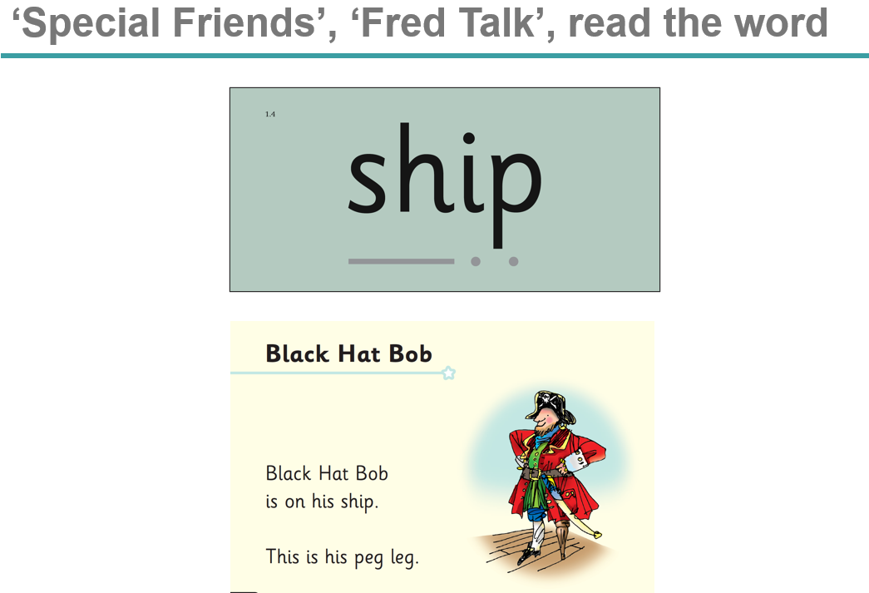
Listening to your child read
Children should be able to read all of the words in their reader.
If they hesitate, remind them to read the word using ‘Special Friends, Fred Talk, read the word’.
For example, this means they spot the ‘sh’, then Fred Talk and blend to read the word e.g. sh, sh-i-p, ship.

Slide 6
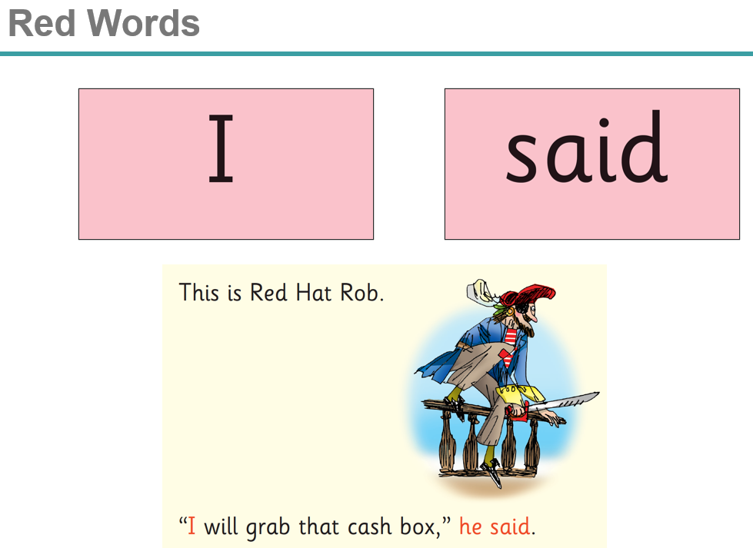
Listening to your child read
Some words are ‘tricky’ because they contain letters that don’t match the sounds the child has been taught.
For example, ‘said’ has ‘ai’ making an ‘e’ sound.
We teach these common exception words as red words (they are commonly known as sight words).
In the early Storybooks, these words are printed in red text.
Remind your child not to use Fred Talk to read Red words but instead to stop and think. Tell them the word if needed.
What can you do?
Listen to your child read the same book over two nights
Encourage them to use ‘Special Friends’, ‘Fred Talk’, ‘read the word’
Discuss the story and encourage their storyteller voice.

